Slide 1
IP Addressing
Dr. Basil Elmasri
b.elmasri@gold.ac.uk

Slide 2
Recommended text books
Computer networking : a top-down approach, James F. Kurose, and Keith W. Ross. 6th edition.
Computer networks, Andrew S. Tanenbaum, and David J. Wetherall. 5th edition.
Computer networks : a systems approach, Larry L. Peterson, and Bruce S. Davie. 5th edition.
Dr. Basil Elmasri
<number>
Notes:
<number>

Slide 3
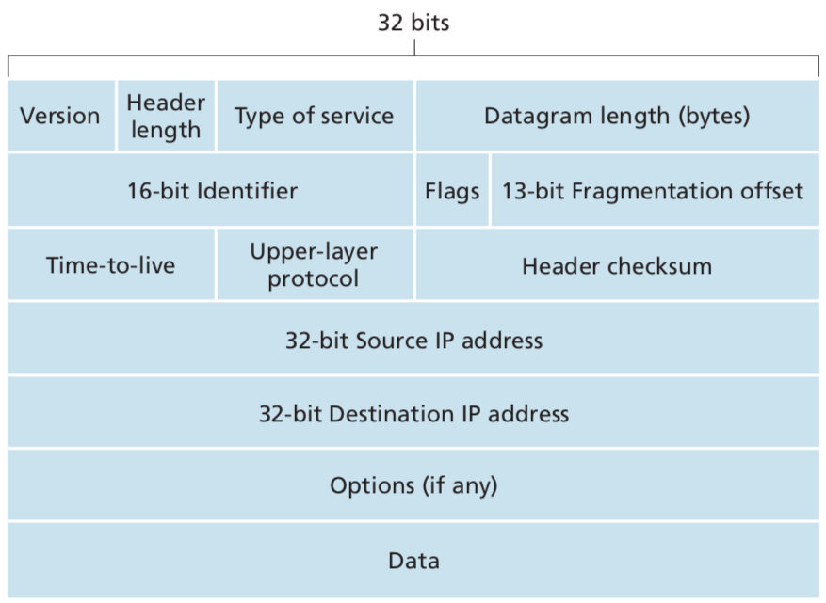
Internet Protocol (IP)
4
Dr. Basil Elmasri
<number>

Slide 4
IP v4 addressing
It is extremely important to know, a central importance to the Internet.
IP address is 32 bit long, divided into 4 equal sections for readability, i.e. 8 bits each part.
Each section ranges between 00000000 – 11111111 in binary
That is 0-255 in decimal.
Few bits on the left-hand side of the IP address represent the network ID, the rest bits to the right represents the Host ID
IP addressing is classified into classes A, B, C, D, and E.
Dr. Basil Elmasri
<number>

Slide 5
Subnet Mask
Any network, for example a network w.x.0.0, with hosts w.x.y.z:
All 0’s host address is reserved for the network ID, e.g. w.x.0.0
All 1’s host address is reserved for broadcasting, e.g. w.x.255.255
Subnet mask is used to find the network ID in an IP address.
Left part of it is 1’s in binary, and the rest is 0’s. Examples:
11111111.00000000.00000000.00000000 => 255.0.0.0
11111111.11111100.00000000.00000000 => 255.252.0.0
Is 255.253.0.0 a valid mask? Convert it to binary and see.
Logical AND operation with an IP address, remember:
1 AND 1 = 1 1 AND 0 = 0 0 AND 0 = 0
Dr. Basil Elmasri
<number>

Slide 6
Example
IP address: 126.201.4.85\15, network ID is: 126.200.0.0
126.201.4.85 01111110.11001001.00000100.01010101
255.254.0.0 11111111.11111110.00000000.00000000
126.200.0.0 01111110.11001000.00000000.00000000
Dr. Basil Elmasri
<number>

Slide 7
Class A
Range: always starts with binary 0 for the 32 bits address
Decimal 1.0.0.0 to 126.255.255.255 and in binary:
00000001.00000000.00000000.00000000 01111110.11111111.11111111.11111111
Default subnet mask for class A is 255.0.0.0 or (\8)
Note that 0.0.0.0 and 127.0.0.0 are not included in class A
127.0.0.0 is for loopback, or localhost.
0.0.0.0 describes an invalid or unknown target
Available networks in class A is 2⁸ – 2 = 126 networks.
Available hosts in each network is 2²⁴ – 2 = 16’777’214
Why – 2 ?
Dr. Basil Elmasri
<number>

Slide 8
Class B
Range: always starts with binary 10 for the 32 bits address
Decimal: 128.0.0.0 to 191.255.255.255 and in binary:
10000000.00000000.00000000.00000000 10111111.11111111.11111111.11111111
Default subnet mask for class B is 255.255.0.0 or (\16)
Available networks in class B is 2¹⁴ = 16384
Available hosts in each network is 2¹⁶ – 2 = 65’534
Dr. Basil Elmasri
<number>

Slide 9
Class C
Range: always starts with 110 for the 32 bits address
Decimal 192.0.0.0 to 223.255.255.255 and in binary:
11000000.00000000.00000000.00000000 11011111.11111111.11111111.11111111
Default subnet mask for class C is 255.255.255.0 or (\24)
Available networks in class C is 2²¹ = 2’097’152
Available hosts in each network is 2⁸ – 2 = 126
Dr. Basil Elmasri
<number>

Slide 10
Class D and Class E
Class D Range: always starts with 1110 for the 32 bits address.
Decimal 224.0.0.0 to 239.255.255.255 and in binary:
11100000.00000000.00000000.00000000 11011111.11111111.11111111.11111111
Class D is reserved for Multicasting.
Class E Address always starts with 11110
Decimal 240.0.0.0 to 255.255.255.254 and in binary:
11100000.00000000.00000000.00000000 11111111.11111111.11111111.11111110
The class E IP addresses are reserved for experimental purposes.
Neither class D nor E has any subnet mask.
All 1’s, 255.255.255.255, is the limited broadcast destination address
Dr. Basil Elmasri
<number>

Slide 11
Classless Inter-Domain Routing (CIDR)
Previous addressing is called of classful.
CIDR allow more allocation of IP addresses.
Example: having 10.0.0.0 allocated, a need for 28 subnetwork.
There are 24 bits available. Some bits to be allocated for networks IDs: 2⁴ < 28 < 2⁵ that is 16 < 28 < 32
5 bits will be reserved for network IDs, 10.0.0.0 to 10.248.0.0
00001010.00000000.00000000.00000000
00001010.11111000.00000000.00000000
Dr. Basil Elmasri
<number>

Slide 12
CIDR example cont.
Network mask is 255.248.0.0 or (\13)
11111111.11111000.00000000.00000000
Subnetworks 2⁵ = 32. hosts per network 2¹⁹ – 2 = 524’286
Example on an available subnetwork : 10.176.0.0
00001010.10110000.00000000.00000000
Broadcast address is 10.183.255.255
00001010.10110111.11111111.11111111
A random host ID will be represented as 10.176.0.2\13
00001010.10110000.00000000.00000010
Another host ID: 10.178.0.0\13
00001010.10110010.00000000.00000000
11111111.11111000.00000000.00000000 <= applying mask?
Dr. Basil Elmasri
<number>

Slide 13
Homework
Which of these is an invalid subnet mask? Why?
127.0.0.0 , 255.255.0.0 , 255. 240.0.0 , 255.255.200.0
You have this network address 144.64.0.0.
What class is it? What would be the default mask?
Using the same address, 7 other subnets are needed.
How many bits will be reserved for the network IDs?
What will be the range, both in decimal and binary?
What will be subnet mask? Give an example of a network ID within the range, two host IDs within the same subnet. What is the broadcast ID of this network?
Demonstrate how the mask works on those hots ID.
Dr. Basil Elmasri
<number>

